Slide 1
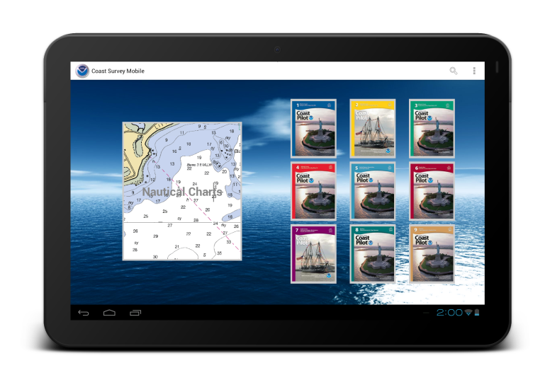

Coast Survey Mobile App
Developed for NOAA’s Office of Coast Survey
by
Lynker Technologies

Slide 2

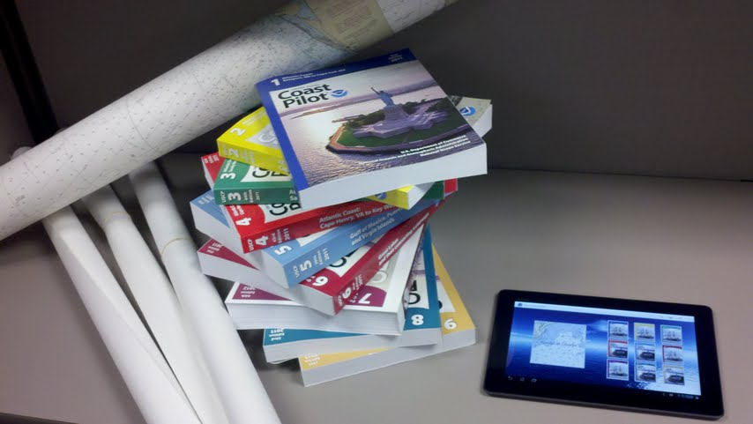
Overview
Coast Survey Mobile (CSM) is an Android tablet application being developed by Lynker Technologies for NOAA’s Office of Coast Survey.
The app integrates Coast Pilot ®
content with NOAA Nautical
Charts. CSM additionally
integrates Nautical Chart displays
with real-time GPS positioning
and tracking.
Coast Survey Mobile is intended
to fulfill official Coast Pilot®
carriage requirements for
commercial mariners, and to
serve as a charting resource for
recreational boaters.

Slide 3
Three Aspects
The app has three integrated facets:
Coast Pilot
  - Proposed to fulfill carriage requirements
Nautical Charts
  - Will NOT fulfill carriage requirements
Location
  - NOT to be used for navigation

Slide 4
Coast Pilot Features
Designed to fulfill US Coast Guard carriage requirements
Links in Coast Pilot take you directly to feature or geographical point on nautical chart
Download one, some, or all books
Weekly automated updates
Search
Bookmarks
Links to regulations

Slide 5
Charting Features
Does NOT fulfill carriage requirements
Base map
  Satellite or Roadmap
Zoom in or zoom out and automatically switch charts to appropriate scale
Location / tracking overlay
Links in charts will take you directly to feature or geographical point section of Coast Pilot

Slide 6
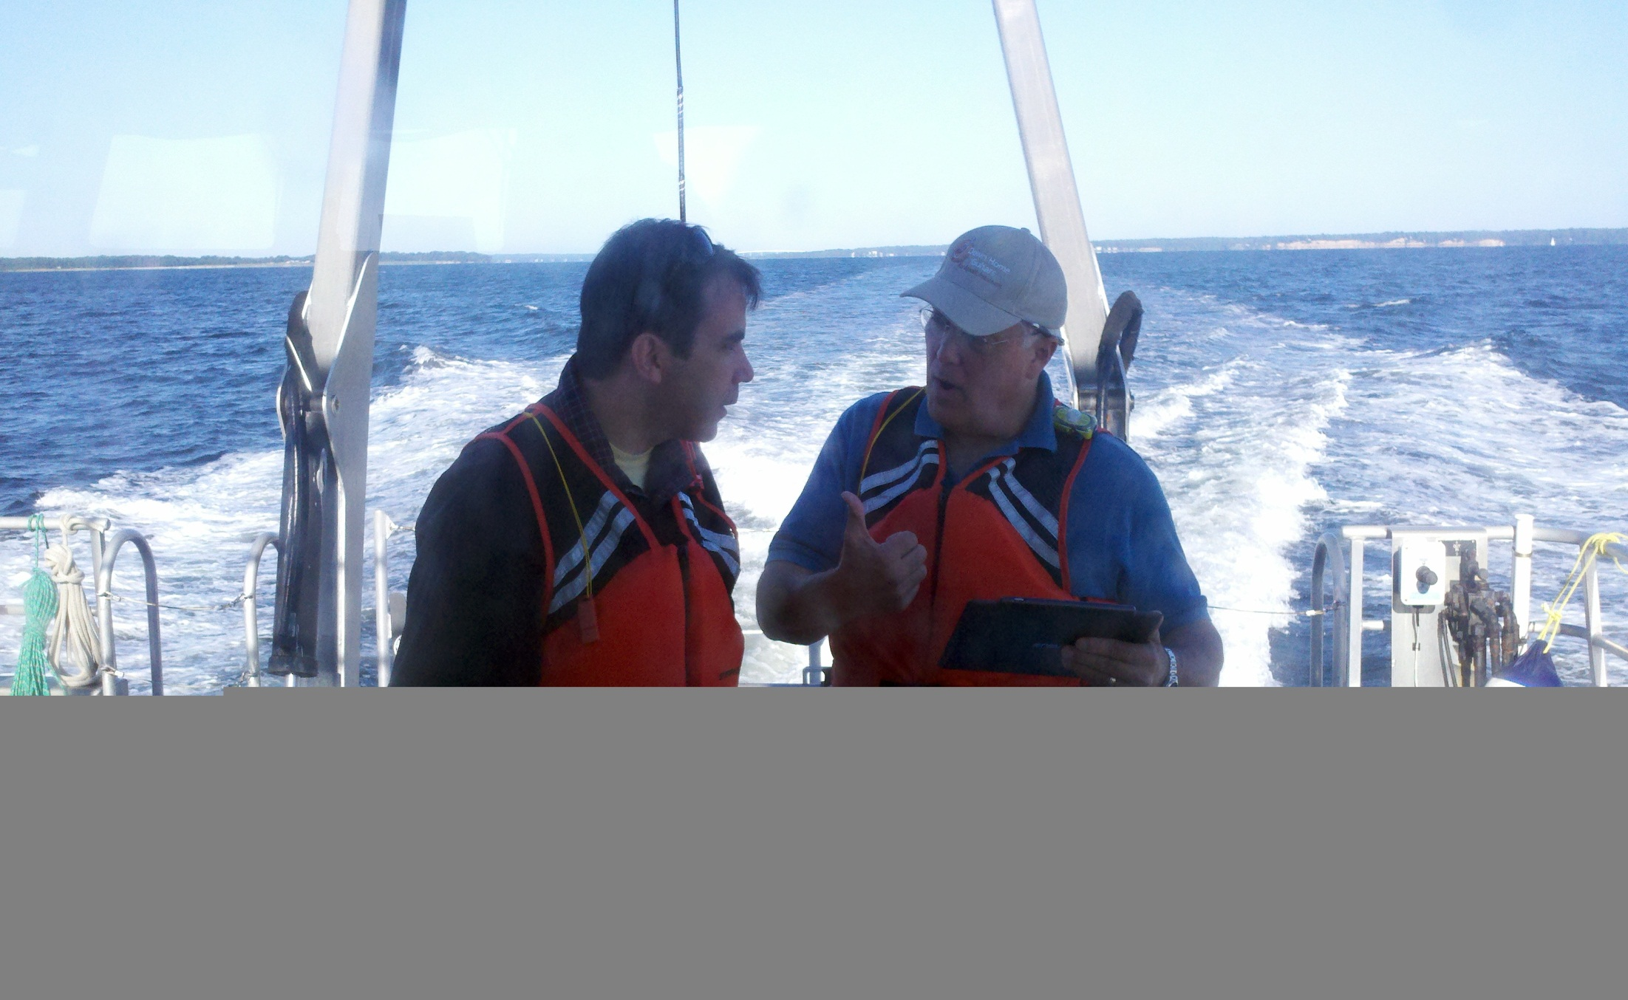
Testing On Bay Hydro II

Slide 7
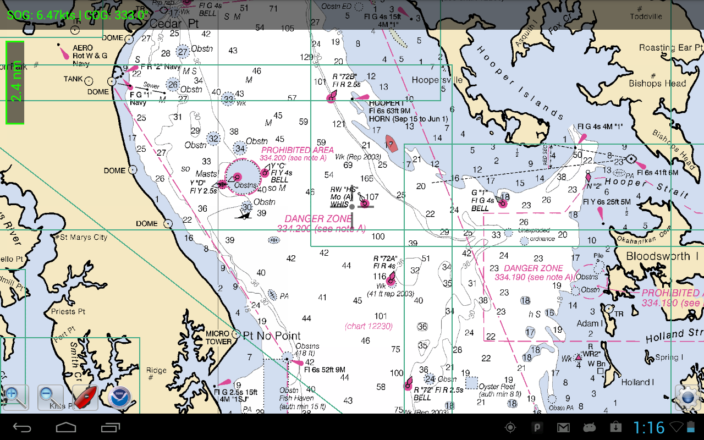
Location Features

Slide 8
Status
Internal company R&D project
  Development started Jan 2012
Registered in SDLC as a “Technology Demonstration”
Resources: project manager, developer, tester
  All part-time
Three-phase development schedule
Weekly builds
Test on NOAA Ship Bay Hydro II Sept 12
Version 1 complete Sept 30, 2012
Many follow-on ideas

Slide 9
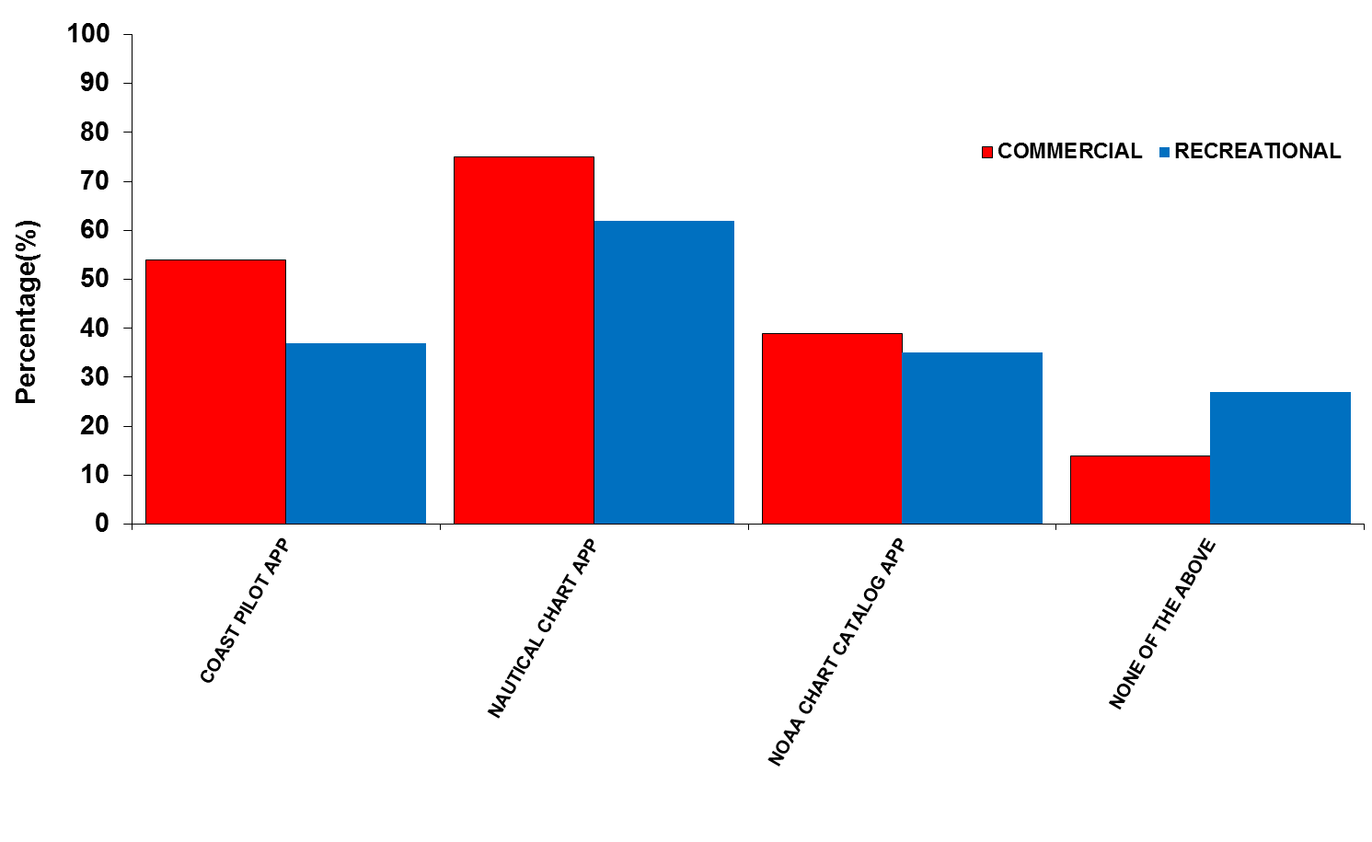
Q.B3 WHICH OF THE FOLLOWING WOULD YOU BE INTERESTED IN USING IN THE FUTURE IF YOU COULD ACCESS IT VIA YOUR CELLPHONE/MOBILE?

Slide 10
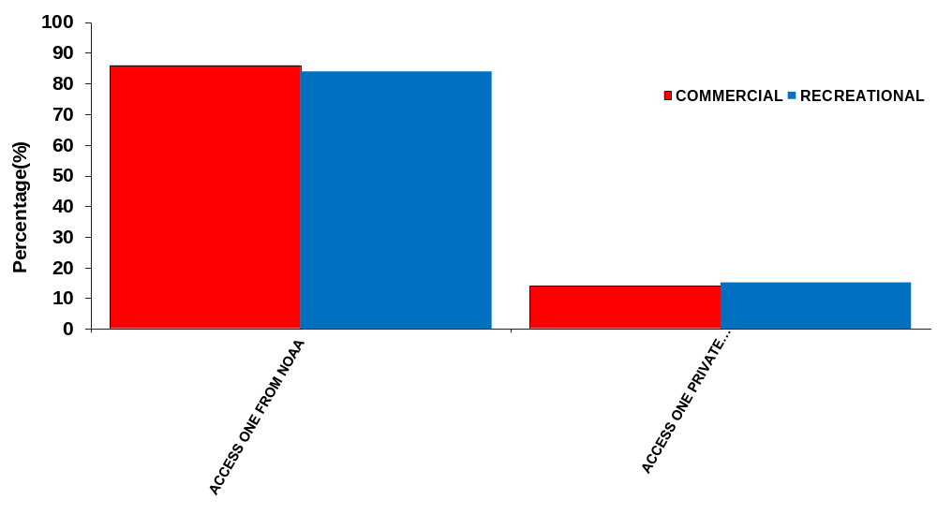
Q.B4 WHICH OF THE FOLLOWING WOULD YOU BE MORE LIKELY TO DO TO ACCESS A MOBILE APP?

Slide 11
Location Features
NOT to be used for navigation
Real-time GPS
Current position overlaid on chart
Displays
  Speed Over Ground
  Course Over Ground
  Bearing
Waypoints
Tracking

Slide 12
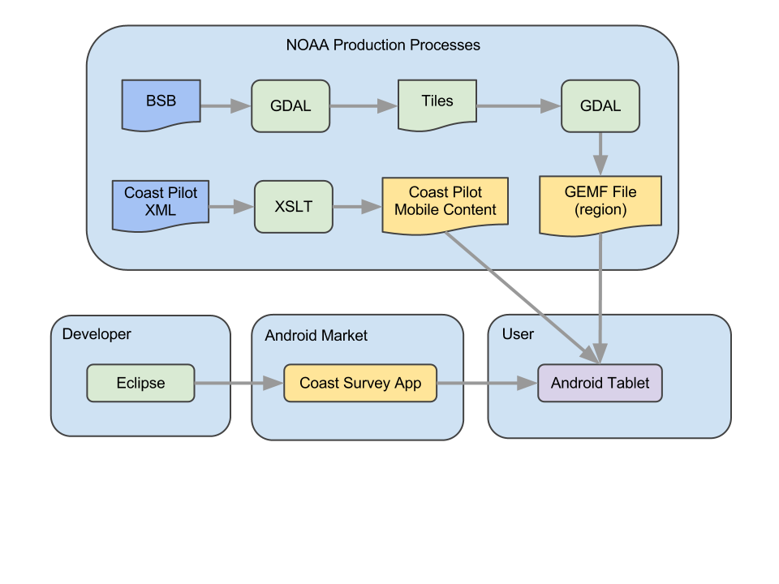
Technical Characteristics
Native app, not web-site
Works connected or unconnected to internet
Written in Java and Python

Slide 13
Contact
Joe Linza
Lynker Technologies
jlinza@lynkertech.com

